Slide 1
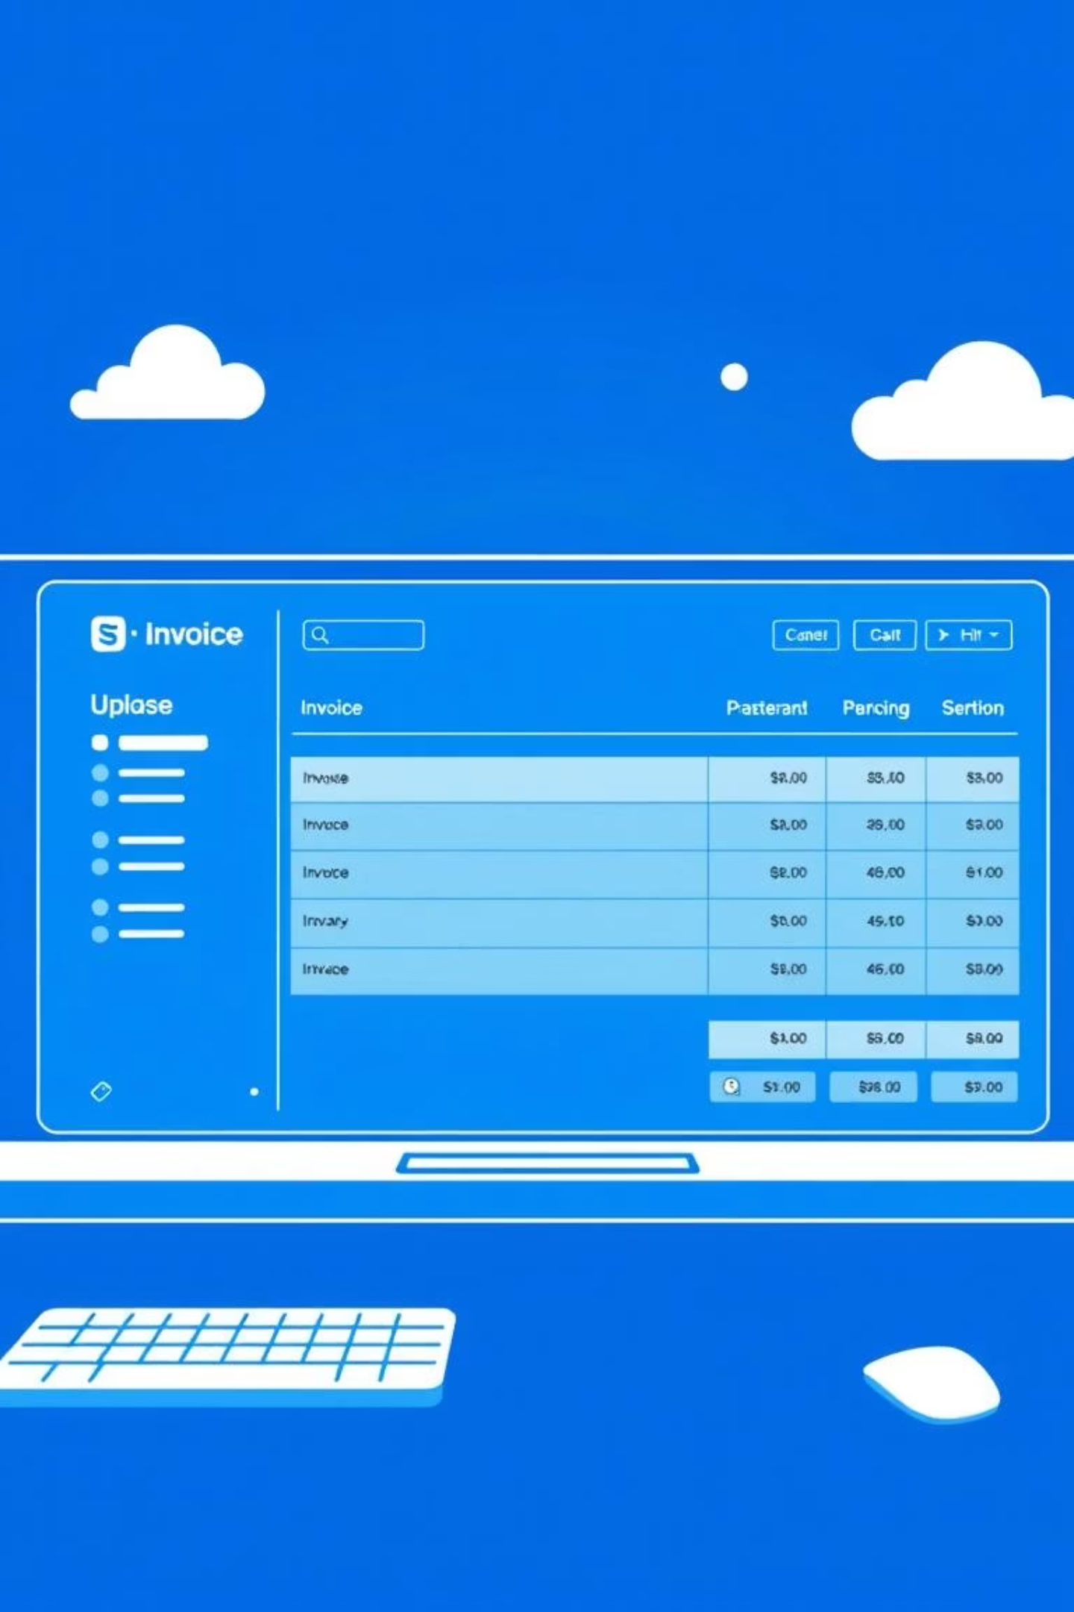
Evaluating Performance and Reliability of Bulk Invoice Upload Feature
BATCH-DD06
Load Testing Case Study
2300030886 | MODEKURTY SRI HARSHA
2300030952 | JONNADULA RAKESH HANUMAN
2300031076 | YAKKANTI SAI HAVINASH REDDY
2300031107 | BOMMIDI VENKATA SAI AMAR NADH

Slide 2


ABSTRACT
Bulk invoice upload is a crucial feature in contemporary enterprise systems because of the daily processing of high volumes of financial transactions, including invoices. Maintaining operational dependability, data accuracy, and business continuity requires that this feature function effectively under high load. Inadequate performance in this area may lead to inconsistent records, delayed processing, and unhappy stakeholders. Therefore, to verify system behavior under various workload conditions, systematic performance and reliability testing is essential. This research emphasizes how the bulk invoice upload feature's performance and reliability are to be evaluated using load testing methods to mimic real world workloads. The approach includes leveraging specialist performance testing tools like Apache JMeter or Locust to mimic controlled invoice upload traffic. Varying levels of loads, from low batches of invoices to thousands, are used to observe how the system reacts both under standard and peak loads. Performance metrics like system response time, throughput, and error rate are measured to identify efficiency and stability. Resource utilization parameters like CPU usage, memory utilization, and database query performance are also tracked by leveraging integrated tools like Grafana and Prometheus. This two-pronged approach of application performance testing and infrastructure monitoring gives an overall idea about the behavior of the system.

Slide 3

The Criticality of Bulk Invoice Uploads
In enterprise environments, bulk invoice upload features are fundamental for efficient financial operations. Untested, they pose significant risks:
Data processing delays impact cash flow and reporting.
System instability leads to financial discrepancies and operational downtime.
Poor performance erodes user trust and increases manual intervention.
User Uploads
App Processes
Database Store
Generate Reports

Slide 4



The Problem: Uncovering Hidden Performance Gaps
The challenge lies in thoroughly understanding how our bulk invoice upload feature performs under stress. We need a systematic approach to:
Simulate realistic high-volume invoice uploads.
Measure performance accurately across various load conditions.
Identify and diagnose potential bottlenecks before they impact production.
Ensure the system can scale to meet future business demands.

Slide 5






Key Objectives: Measuring Success
Our performance evaluation focuses on critical metrics that define system health and user experience.
Response Time
Throughput
Error Rate
Time taken for each upload operation.
Number of invoices processed per unit of time.
Percentage of failed uploads or processing errors.
Resource Utilization
Database Spikes
CPU, Memory, and Disk I/O during peak load.
Monitoring database connection pools and query performance.

Slide 6






Methodology: A Structured Approach
Our evaluation follows a rigorous, multi-step process to ensure comprehensive analysis.
Test Design
Define scenarios, test data, and load profiles.
Upload Batches
Execute simulated bulk invoice uploads.
Monitor Metrics
Collect real-time performance data.
Analyze Results
Interpret data, identify trends and anomalies.
Report Findings
Summarize performance, bottlenecks, and recommendations.

Slide 7
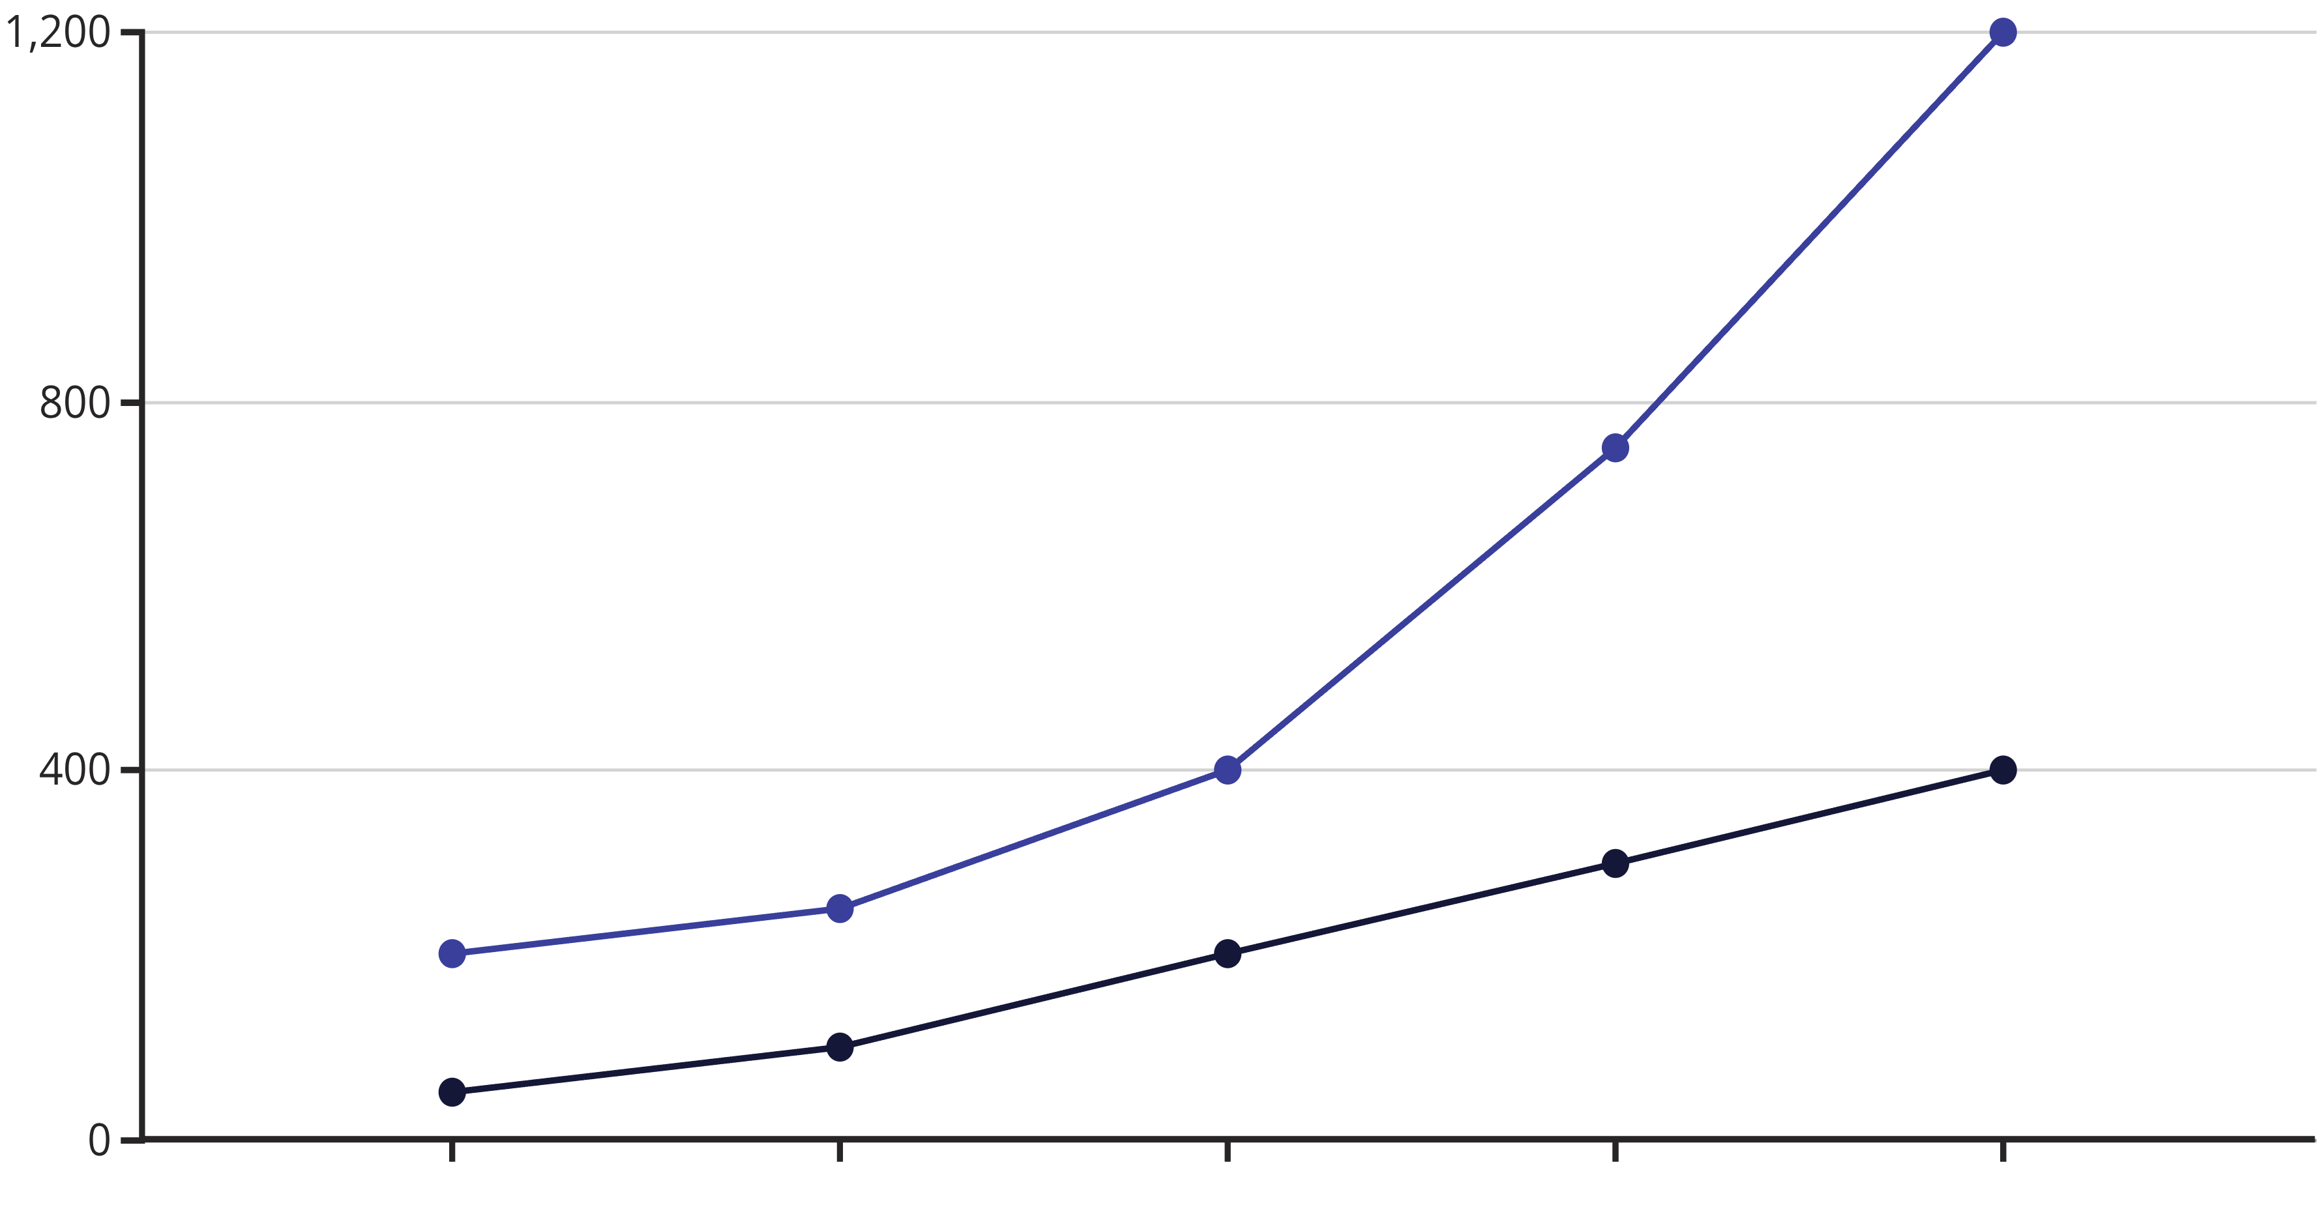

Performance Insights: Load vs. Response Time
Concurrent Users
Response Time (ms)
As concurrent users increase, the average response time for invoice uploads shows a significant upward trend, indicating potential scalability limits beyond 300 users.

Slide 8
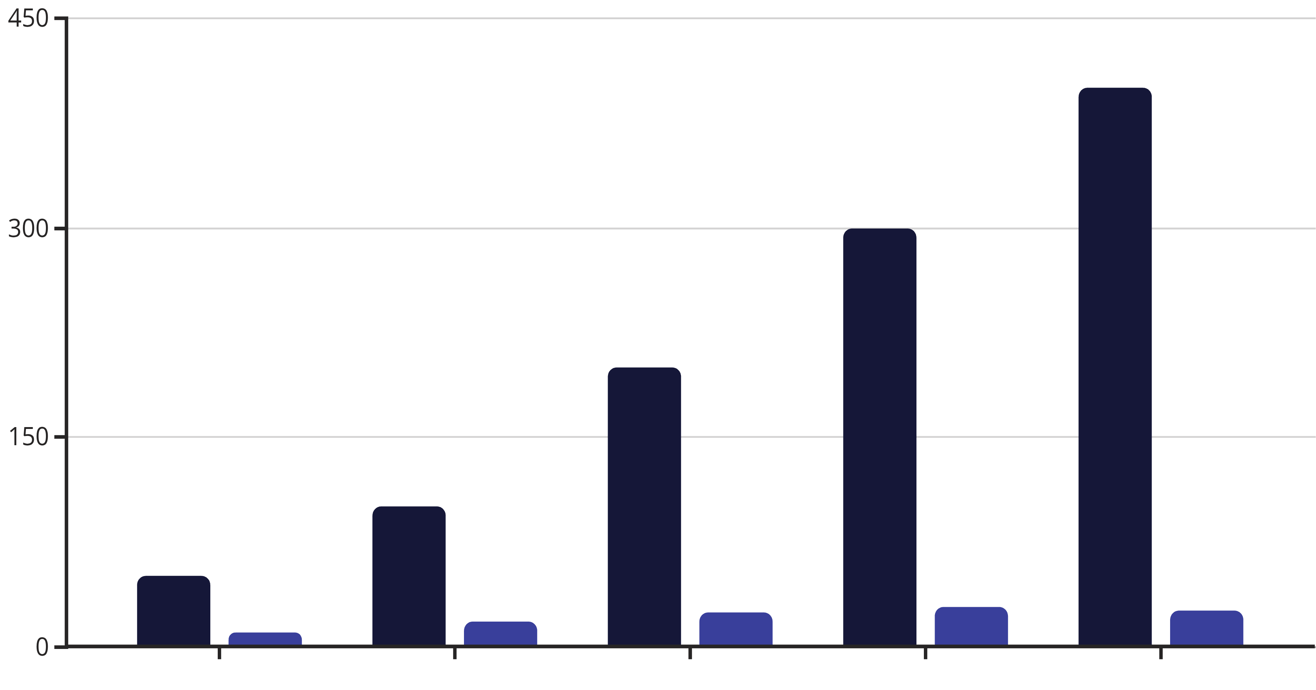

Performance Insights: Load vs. Throughput
Concurrent Users
Throughput (invoices/sec)
Throughput peaks around 300 concurrent users, suggesting resource saturation beyond this point, where additional users do not result in increased processing capacity.

Slide 9
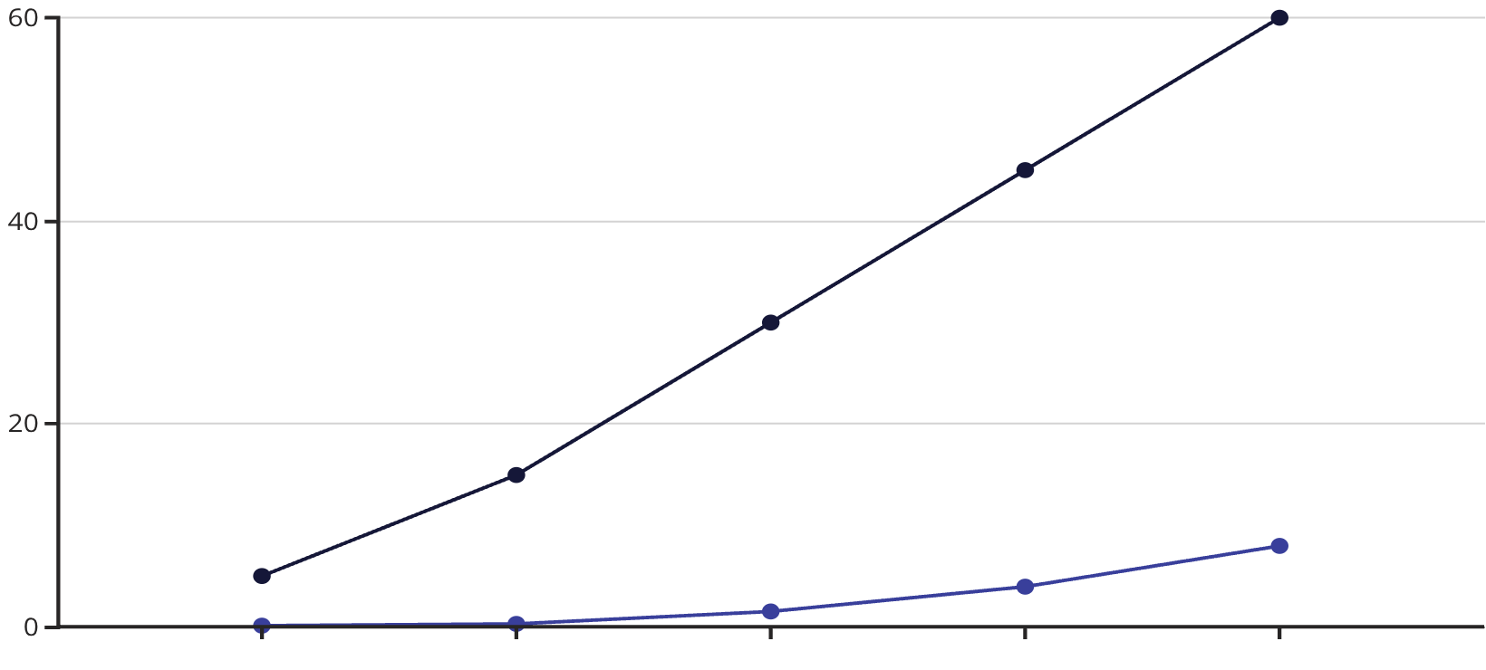
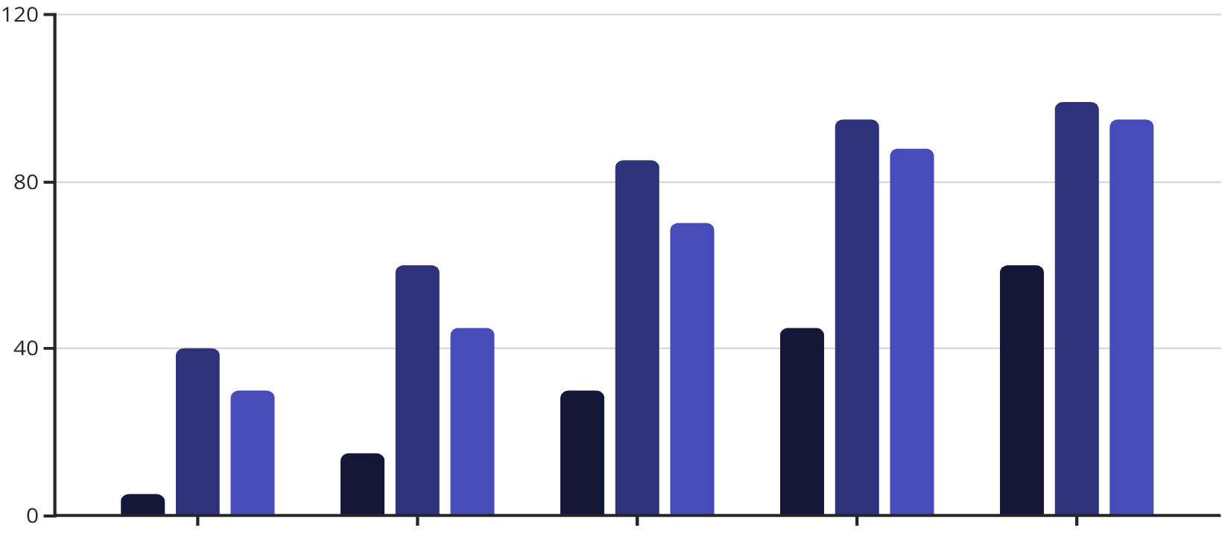
Performance Insights: Error Rates and Resource Use
Test Duration (min)
Error Rate (%)
Test Duration (min)
CPU (%)
Memory (%)
Error rates escalate significantly with extended test duration, pointing to potential memory leaks or resource exhaustion over time.
Both CPU and memory utilization reach critical levels as the load duration extends, confirming resource exhaustion contributing to performance degradation.

Slide 10

Expected Output: Actionable Insights
The performance evaluation will deliver a clear roadmap for optimizing the bulk invoice upload feature.
Performance Limits
Bottleneck Identification
Quantified thresholds for concurrent users and invoice volumes before degradation.
Pinpointing exact system components causing slowdowns (e.g., database, application server, network).
Optimization Recommendations
Specific, prioritized actions for code optimization, infrastructure scaling, or configuration tuning.

Slide 11

Conclusion: Building Enterprise-Ready Solutions
Our rigorous performance and reliability evaluation ensures the bulk invoice upload feature is:
Scalable
Reliable
Enterprise-Ready
Capable of handling increasing volumes of data and users without compromising performance.
Operating consistently and accurately, minimizing errors and ensuring data integrity.
Meeting the high standards required for critical business operations in large organizations.
This proactive approach safeguards financial operations and enhances user confidence.

